Slide 1
MIXTURE & ALLIGATION
(L – 1)

Slide 2
Mixture and Alligation
  Mixing of two or more quantities
  Continuous replacement problems
  Introduction of Alligation
  Application of Alligation (Average, Percentage, Profit & loss)
  Data Sufficiency Questions

Slide 3
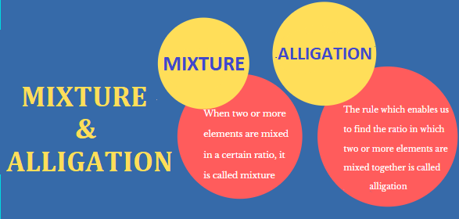

Slide 4
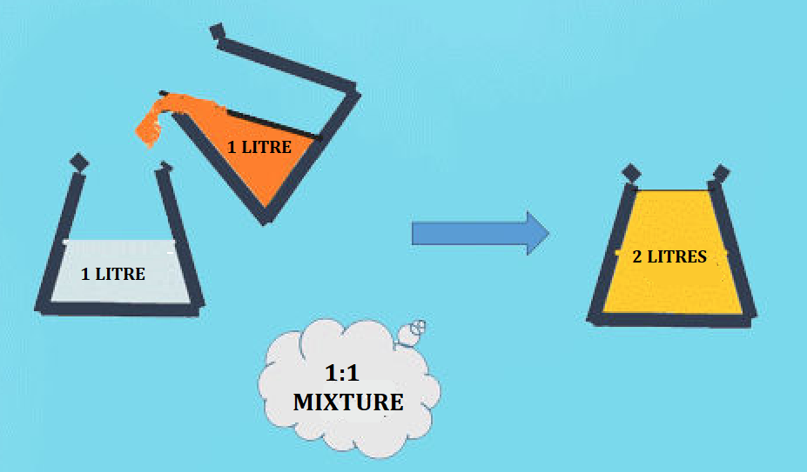
MIXTURE AND ALLIGATION
Mixture: Mixture refers to the mix that is derived as a result of mixing two or more items or substances in a certain ratio or proportion
Alligation: It is the rule that enables us to find the ratio in which two or more ingredients at the given price must be mixed to produce a mixture of a desired price.

Slide 5
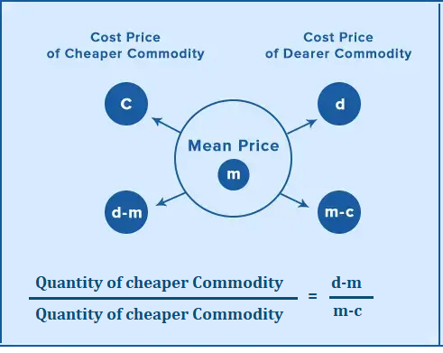
RULE OF ALLIGATION

Slide 6
MIXTURE AND ALLIGATION
Zinc and copper are in the ratio of 5 : 3 in 200 gm of an alloy. How much grams of copper be added to make the ratio as 3 : 5?
A] 133 (1/3) B] 1 / 200
C] 72 D] 66
Notes:
Correct Option : A
Compulsory
Difficulty level : easy

Slide 7
MIXTURE AND ALLIGATION
2. 200 litres of a mixture contains milk and water in the ratio 17 : 3. After the addition of some more milk to it, the ratio of milk to water in the resulting mixture becomes 7 :1. The quantity of milk added to it was
A] 20 litres B] 60 litres
C] 80 litres D] 40 litres
Notes:
Correct Option : D
Compulsory
Difficulty level : easy

Slide 8
MIXTURE AND ALLIGATION
3. A and B are two alloys of gold and copper prepared by mixing metals in ratios 7 : 2 and 7 : 11 respectively. If equal quantities of the alloys are melted to form a third alloy C, the ratio of gold and copper in C will be;
A] 7:5 B] 5:9
C] 9:5 D] 5:7
Notes:
Correct Option : A
Compulsory
Difficulty level: Moderate

Slide 9
MIXTURE AND ALLIGATION
4. Two alloys contain tin and iron in the ratio of 1 : 2 and 2 : 3. If the two alloys are mixed in the proportion of 3 : 4 respectively (by weight), the ratio of tin and iron in the newly formed alloy is :
A] 10:21 B] 13:22
C] 14:25 D] 12:23
Notes:
Correct Option : B
Compulsory
Difficulty level: Moderate

Slide 10
MIXTURE AND ALLIGATION
5. A container contains two liquids A and B in the ratio 7 : 5. When 9 litres of mixture is drawn off and the container is filled with B, the ratio of A and B becomes 1:1. How many litres of liquid A was in the container initially ?
A] 26 B] 16 (1/2)
C] 36 (3/4) D] 26 (3/4)
Notes:
Correct Option : C
Compulsory
Difficulty level : Moderate

Slide 11
MIXTURE AND ALLIGATION
6. A barrel contains a mixture of wine and water in the ratio 3 : 1. How much fraction of the mixture must be drawn off and substituted by water so that the ratio of wine and water in the resultant mixture in the barrel becomes 1 : 1 ?
A] 1/4 B] 1/3
C] 3/4 D] 2/3
Notes:
Correct Option : B
Compulsory
Difficulty level : Moderate

Slide 12
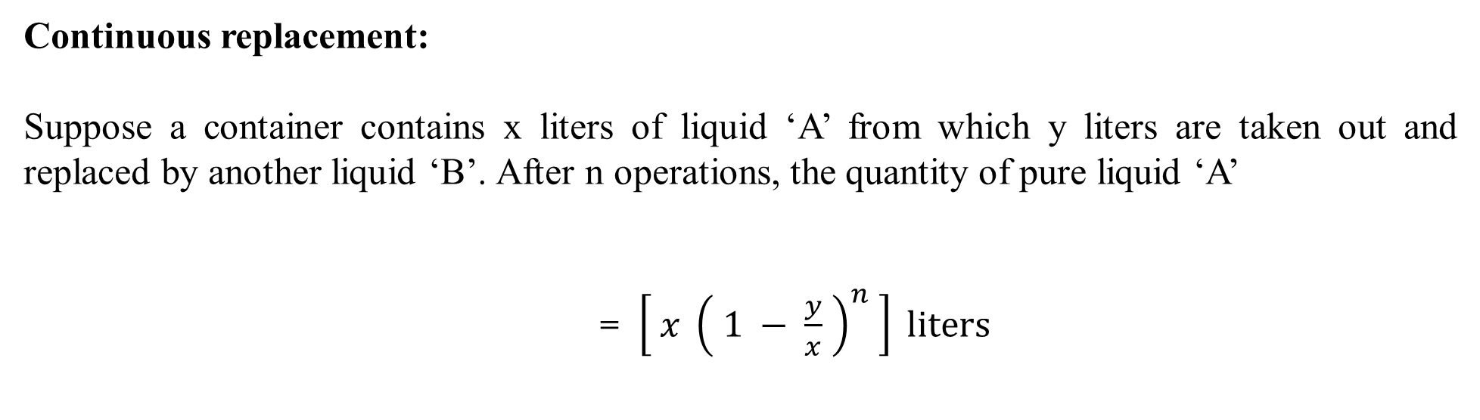
MIXTURE AND ALLIGATION

Slide 13
MIXTURE AND ALLIGATION
7. A container contains 60 kg of milk. From this container 6 kg of milk was taken out and replaced by water. This process was repeated further two times. The amount of milk left in the container is
A] 34.34 kg B] 39.64 kg
C] 43.74 kg D] 47.6 kg
Notes:
Correct Option : C
Compulsory
Difficulty level: Moderate

Slide 14
MIXTURE AND ALLIGATION
8. 8 liters are drawn from a cask full of wine and is then filled with water. This operation is performed two more times. The ratio of the quantity of wine and water is 8:19 now. How much wine did the cask hold originally?
A] 24 L B] 32 L
C] 27 L D] 40 L
Notes:
Correct Option : A
Compulsory
Difficulty level: Difficult

Slide 15
MIXTURE AND ALLIGATION
Alligation:
It is the rule that enables us to find the ratio in which two or more ingredients at the given price must be mixed to produce a mixture of desired price.
Mean Price:
The cost of a unit quantity of the mixture is called the mean price.

Slide 16
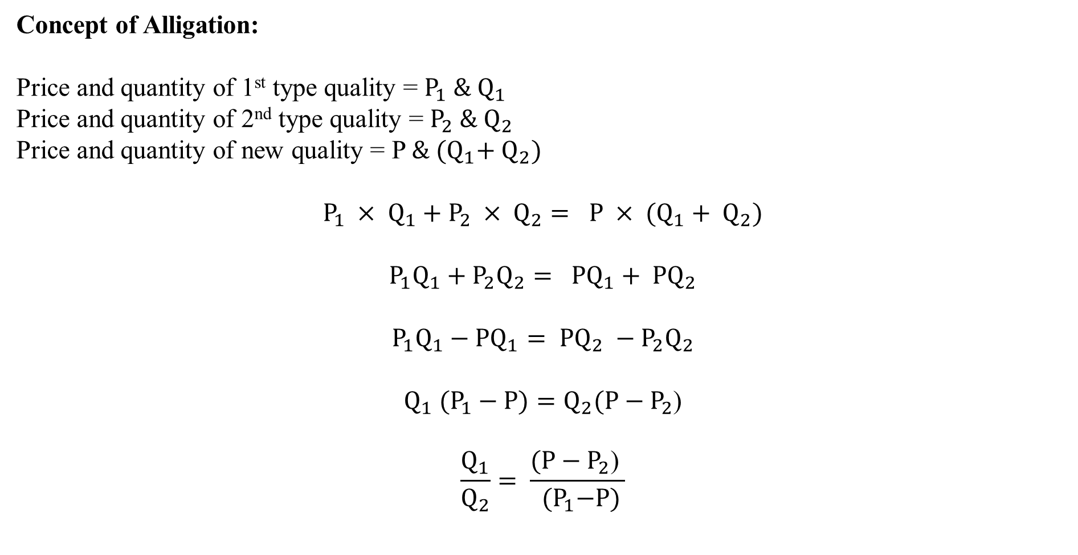
MIXTURE AND ALLIGATION

Slide 17


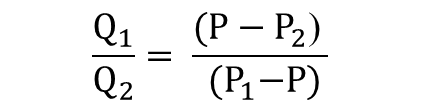
MIXTURE AND ALLIGATION
P₁
P₂
P

Slide 18
MIXTURE AND ALLIGATION
9. A salesman mixes two varieties of tea, that costs Rs. 30 and Rs. 60 per kg respectively. In what proportion the two varieties are to be mixed if the resultant price of tea be Rs. 44 per kg ?
A] 8:7 B] 5:9
C] 9:5 D] 5:7
Notes:
Correct Option : A
Compulsory
Difficulty level: Easy

Slide 19
MIXTURE AND ALLIGATION
10. The ratio of the quantities of sugar, in which sugar costs Rs. 20 per kg. and Rs. 15 per kg. are mixed so that there will be neither loss nor gain on selling the mixed sugar at Rs. 14.
A] 6:1 B] 1:6
C] 4:1 D] Not possible
Notes:
Correct Option : D
Compulsory
Difficulty level: Easy

Slide 20
MIXTURE AND ALLIGATION
11. A salesman mixes two varieties of tea, that costs Rs. 60 and Rs. 45 per kg respectively. In what proportion the two varieties are to be mixed so as to make a profit of 25% if the sale price be Rs. 62.50 per kg ?
A] 2:3 B] 1:2
C] 1:3 D] 2:5
Notes:
Correct Option : B
Compulsory
Difficulty level: Moderate

Slide 21
MIXTURE AND ALLIGATION
12. How many kilogram of sugar costing Rs. 9 per kg must be mixed with 27 kg of sugar costing Rs. 7 per kg so that there may be a gain of 10% by selling the mixture at Rs. 9.24 per kg?
A] 36 kg B] 42 kg
C] 54 kg D] 63 kg
Notes:
Correct Option : D
Compulsory
Difficulty level: Moderate

Slide 22
MIXTURE AND ALLIGATION
13. The cost of Type 1 rice is Rs. 15 per kg and Type 2 rice is Rs. 20 per kg. If both Type 1 and Type 2 are mixed in the ratio of 2 : 3, then the price per kg of the mixed variety of rice is:
A] Rs. 18 B] Rs. 18.50
C] Rs. 19 D] Rs. 19.50
Notes:
Correct Option : A
Compulsory
Difficulty level: Moderate

Slide 23
MIXTURE AND ALLIGATION
14. Tea worth Rs. 126 per kg and Rs. 135 per kg are mixed with a third variety in the ratio 1:1:2. If the number of worth Rs. 153 per kg, then find the price of third variety per kg?
A] Rs. 170 B] Rs. 150
C] Rs. 180 D] Rs. 175.5
Notes:
Correct option : D
Compulsory
Difficulty level: Difficult

Slide 24
MIXTURE AND ALLIGATION
15. A dishonest milkman professes to sell his milk at cost price but he mixes it with water and thereby gains 25%. The percentage of water in the mixture is?
A] 66% B] 60%
C] 20% D] 45%
Notes:
Correct option : C
Compulsory
Difficulty level: Difficult

Slide 25
MIXTURE AND ALLIGATION
16. The ratio in which two sugar solutions of the concentrations 15% and 40% are to be mixed to get a solution of concentration 30% is
A] 2:3 B] 3:2
C] 8:9 D] 9:8
Notes:
Correct option : A
Compulsory
Difficulty level: Easy

Slide 26
MIXTURE AND ALLIGATION
17. Two vessels contain milk and water in the ratio 3 : 2 and 7 : 3. Find the ratio in which the contents of the two vessels have to be mixed to get a new mixture in which the ratio of milk and water is 2 : 1.
A] 1:2 B] 3:2
C] 4:1 D] 1:4
Notes:
Correct option : B
Compulsory
Difficulty level: Moderate

Slide 27
MIXTURE AND ALLIGATION
18. Two vessels A and B contain milk and water mixed in the ratio 5:7 and 7:17 respectively. Find the ratio in which these mixture to obtain a new mixture in vessel C containing milk and water in the ratio 17:31?
A] 1:1 B] 2:1
C] 3:8 D] 4:7
Notes:
Correct option : A
Difficulty level: Moderate

Slide 28
MIXTURE AND ALLIGATION
19. In a class, the average score of girls in an examination is 73 and that of boys is 71. The average score for the whole class is 71.8. Find the percentage of girls.
A] 50% B] 40%
C] 55% D] 60%
Notes:
Correct option : B
Compulsory
Difficulty level: Easy

Slide 29
MIXTURE AND ALLIGATION
20. The total population of a village is 5000. The number of males and females increased by 10% and 15% respectively and consequently the population of the village becomes 5600. What was the number of males in the village?
A] 3000 B] 3400
C] 3800 D] 2400
Notes:
Correct option: A
Compulsory
Difficulty level: Moderate

Slide 30
MIXTURE AND ALLIGATION
21. A businessman lends Rs.1800 in two parts at simple interest. He lends one part at 10% p.a. and other at 15% p.a. At the end of the year, the average interest worked out to be 11 (1/3) % p.a. Find out the interest earned by the businessman from the part which was lent at 10% p.a.
A] Rs.70 B] Rs.132
C] Rs.72 D] Rs.130
Notes:
Correct option : B
Compulsory
Difficulty level: Difficult

Slide 31
MIXTURE AND ALLIGATION
22. A merchant has 1000 kg of sugar, part of which he sells at 8% profit and the rest at 18% profit. He gains 14% on the whole. The quantity sold at 18% profit is:
A] 400 kg B] 560 kg
C] 600 kg D] 640 kg
Notes:
Correct option : C
Compulsory
Difficulty level: Moderate

Slide 32
MIXTURE AND ALLIGATION
23. A man travelled a distance of 61 km in 9 hours. He travelled some distance on foot at a speed of 4 km/hr and remaining on a bicycle at a speed of 9 km/hr. The distance travelled on foot is-
A] 12 km B] 16 km
C] 30 km D] 24 km
Notes:
Option B
Compulsory
Difficulty level: Moderate

Slide 33
MIXTURE AND ALLIGATION
24. There are 2 types of animal in a zoo, 2 legged animals and 4 legged animals. Total number of legs are 16 and total number of heads are 6. How many 2 legged animals are present in the zoo?
A] 2 B] 3
C] 4 D] 5
Notes:
Option C
Difficulty level: Easy

Slide 34
MIXTURE AND ALLIGATION
25. A certain solution is 77% glycol by volume. How many liters of this solution must be added to 42 liters of a 53% glycol solution in order to produce a solution with an overall concentration of 60%?
A] 27.4 ltrs B] 23.2 ltrs
C] 42.0 ltrs D] 17.3 ltrs
Notes:
Option- D
Difficulty level: Moderate
0.77x+0.53(42)=0.60(x+42)
0.77x+0.53(42)=0.60x+0.60(42)
0.17x=42(0.6-0.53)
x=42(0.07)/(0.17)
X = 17.3 liters

Slide 35
MIXTURE AND ALLIGATION
26. Two jars of equal capacity each contain a saltwater solution. The first jar is 40% full, and its solution is 60% salt. If the contents of the second jar are emptied into the first jar, the solution, which will fill the jar completely, will be 30% salt. What is the salt concentration of the contents of the second jar?
A] 10% B] 2%
C] 18% D] 20%
Notes:
Option- A
Explanation: For the sake of simplicity, let us assume that each jar has capacity 100 milliliters; the reasoning is the same regardless of the common capacity.
The first jar is 40% full, so there are 100 x 40%=100⋅0.40=40 milliliters of solution in the jar; the solution is 60% salt, so there are 40 x 60%=40 x 0.60=24 milliliters of salt in the solution.
For the first jar to be filled to capacity, 100−40=60 milliliters of solution must be added. Also, if the solution is 30% salt, then the jar will contain100 x 30%=100 x 0.30=30 milliliters of salt. This means that 30−24=6 milliliters of salt will have been added. This means that the concentration of salt in the added solution - the contents of the second jar – is 6/60 x 100%=10%.

Slide 36
MIXTURE AND ALLIGATION
27. Some amount out of Rs. 10000 was lent at 6 % p.a. and the remaining at 4% p.a. If the total simple interest from both the fractions in 5 years was Rs. 2250, then the ratio of the 2 different amount is
A] 1 : 3 B] 3 : 1
C] 1 : 4 D] 3 : 2
Notes:
Option - A

Slide 37
MIXTURE AND ALLIGATION
28. How much water does a chemist need to dilute a pure solution of chlorine in order to obtain 150 ml of solution?
I. The chemist would like the final solution to be 15% chlorine.
II. There is no chlorine in water.
A] Statement I ALONE is sufficient, but Statement (2) ALONE is not sufficient.
B] Statements I and II TOGETHER are not sufficient.
C] Each Statement ALONE is sufficient.
D] Both statements TOGETHER are sufficient, but NEITHER statement ALONE is sufficient.
E] Statement II ALONE is sufficient, but Statement I ALONE is not sufficient.
Notes:
Option- A.
Explanation:(1) The chemist would like the final solution to be 15% chlorine.
The final solution is 150 ml and contains 15% of chlorine. Let x be the amount of water, then 150-x is the amount of the original chlorine solution. The amount of chlorine in the original solution is the same in the final solution, only the concentration changes.
150−x=0.15×150=22.5
x=150−22.5=127.5
(2) There is no chlorine in water.
Statement (2) is not helpful as it does not help in finding the amount of chlorine in the final solution.

Slide 38
MIXTURE AND ALLIGATION
29. Two hydrochloric acid solutions, one of concentration 40% and one of concentration 25%, are mixed together to make a solution of 35% concentration. How much solution is made?
Statement I: 200 ml of 40% conc. solution is used.
Statement II: 100 ml of 25% conc. solution is used
A] Only I B] Only II
C] Both I and II D] Either I or II
Notes:
Option D
Compulsory
Difficulty level: Moderate

Slide 39
MIXTURE AND ALLIGATION
30. What quantity of solution is obtained by diluting x litres of pure acid with water?
Statement I: The final solution contains 20% of acid.
Statement II: x = 20 ml
A] Only I B] Only II
C] Both I and II D] Either I or II
Notes:
Option C
Difficulty level: Moderate

Slide 40
MIXTURE AND ALLIGATION
(Q31 – Q35)A mixture of water, milk and honey contains 44 litres more water than milk in it. Also, quantity of honey in it is 30% less than that of water in it. If half of the mixture is replaced with 18 litres of milk, then ratio of quantities of milk and honey in the resultant mixture becomes 4:3, respectively.
31. Find original quantity of water.
A. 120 litres
B. 100 litres
C. 96 litres
D. 90 litres
Notes:
A

Slide 41
MIXTURE AND ALLIGATION
(Q31 – Q35)A mixture of water, milk and honey contains 44 litres more water than milk in it. Also, quantity of honey in it is 30% less than that of water in it. If half of the mixture is replaced with 18 litres of milk, then ratio of quantities of milk and honey in the resultant mixture becomes 4:3, respectively.
32. Find original quantity of milk.
A. 86 litres
B. 70 litres
C. 76 litres
D. 66 litres
Notes:
C

Slide 42
MIXTURE AND ALLIGATION
(Q31 – Q35)A mixture of water, milk and honey contains 44 litres more water than milk in it. Also, quantity of honey in it is 30% less than that of water in it. If half of the mixture is replaced with 18 litres of milk, then ratio of quantities of milk and honey in the resultant mixture becomes 4:3, respectively.
33. Find original quantity of honey.
A. 70 litres
B. 84 litres
C. 60 litres
D. 96 litres
Notes:
B

Slide 43
MIXTURE AND ALLIGATION
(Q31 – Q35)A mixture of water, milk and honey contains 44 litres more water than milk in it. Also, quantity of honey in it is 30% less than that of water in it. If half of the mixture is replaced with 18 litres of milk, then ratio of quantities of milk and honey in the resultant mixture becomes 4:3, respectively.
34. Milk and honey together formed how much proportion of the original mixture?
A. 5/8
B. 4/7
C. 3/7
D. 5/11
Notes:
B

Slide 44
MIXTURE AND ALLIGATION
(Q31 – Q35)A mixture of water, milk and honey contains 44 litres more water than milk in it. Also, quantity of honey in it is 30% less than that of water in it. If half of the mixture is replaced with 18 litres of milk, then ratio of quantities of milk and honey in the resultant mixture becomes 4:3, respectively.
35. Find the ratio of quantities of milk and water in the resultant mixture .
A. 19:29
B. 19: 35
C. 19:30
D. None of these
Notes:
D

Slide 45
Any Doubts???

